Slide 1
Enterprise Developer Camp Jumpstart
Robert Green | Technical Evangelist
Dmitry Lyalin | Product Marketing Manager

Slide 2
Meet Robert Green | ‏@rogreen_ms
Technical Evangelist in the Developer & Platform Evangelism (DPE) group
Focuses on Visual Studio and enterprise development
Host of the Visual Studio Toolbox show on Channel 9

Slide 3
Meet Dmitry Lyalin| @lyalindotcom‏
Product Manager focusing on Visual Studio
Has been building software for more than 16 years
Loves building mobile apps and Azure cloud services
Is an avid PC gamer

Slide 4


Course Topics
Enterprise Developer Camp Jump Start
01 | Devices and Services
02 | Adopt a Services Architecture
03 | Move to the Cloud
04 | Build Modern Looking Apps
05 | Build for Multiple Devices

Slide 5
Setting Expectations
Target Audience
Developers with existing .NET client line of business (LOB) applications
Want to see how to modernize these applications and move them forward
Assumed Knowledge
Have built XAML apps
Basic knowledge of what Azure offers
Basic knowledge with Windows 8 and Windows Phone OSs

Slide 6

Join the MVA Community!
Microsoft Virtual Academy
Free online learning tailored for IT Pros and Developers
Over 1M registered users
Up-to-date, relevant training on variety of Microsoft products
“Earn while you learn!”
Get 50 MVA Points for this event!
Visit http://aka.ms/MVA-Voucher
Enter this code: EntDevCmp (expires 3/5/2014)

Slide 7
01 | Devices and Services
Robert Green | Technical Evangelist

Slide 8
Course Introduction

Slide 9
Module Overview
Set the Stage
Devices
Services

Slide 10
Set the Stage

Slide 11

Devices
Services

Slide 12







client/server
device/services

Slide 13
Devices

Slide 14
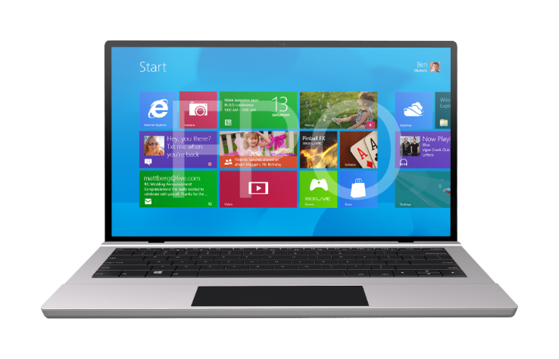
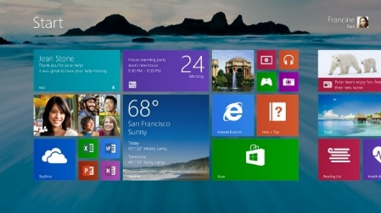



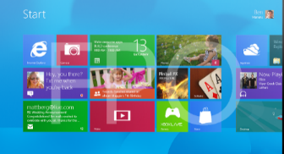
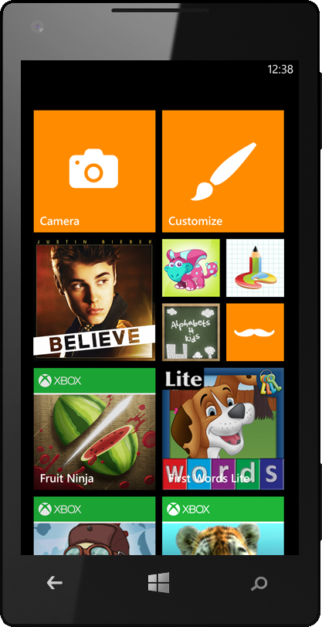
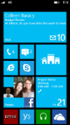
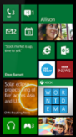
Touch-first experience
Integrated stores
Existing skills, code
Developing for Windows

Slide 15
Windows
Apps
XAML
HTML
C
C++
C#
Visual Basic
JavaScript
Windows Runtime
Developing for Windows

Slide 16


























IMAG PIP area
IMAG PIP area
CLOSED CAPTIONING TEXT AREA

Slide 17
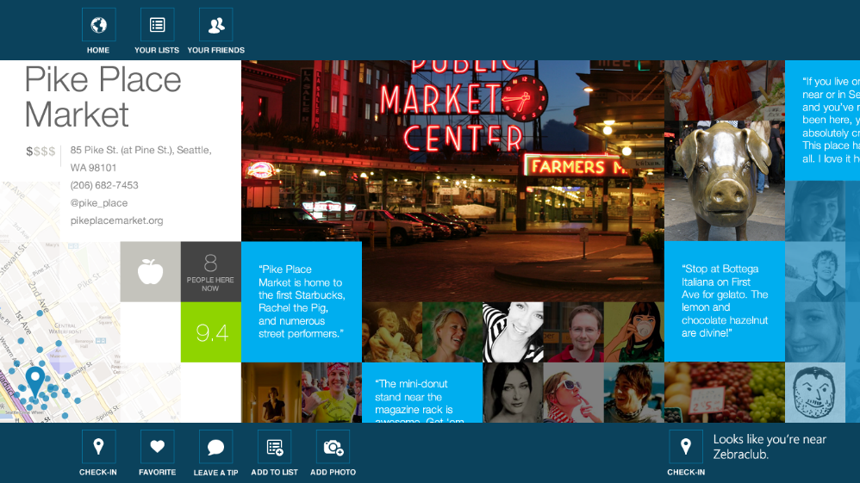


“The first serious tablet version of the check-in app is here.” - Harry McCracken, Time
CLOSED CAPTIONING TEXT AREA

Slide 18
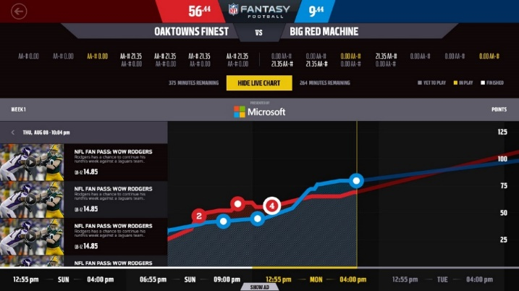


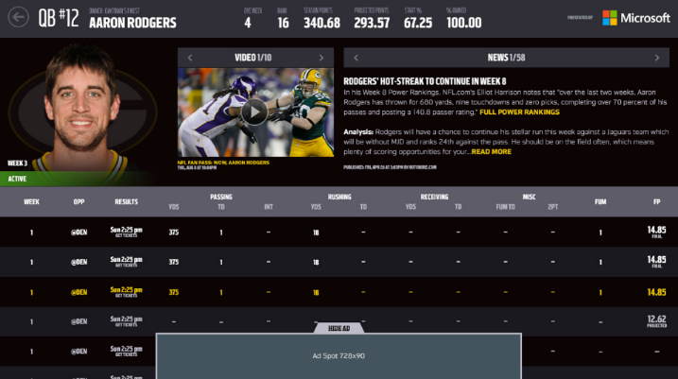
Fantasy Football
CLOSED CAPTIONING TEXT AREA

Slide 19


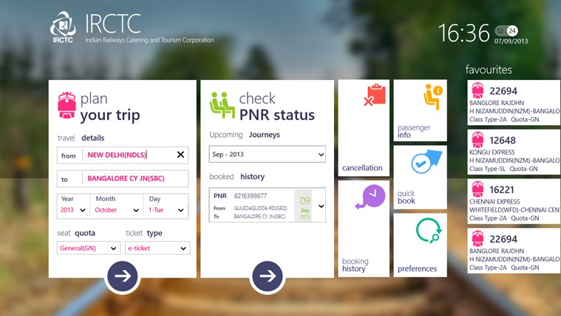
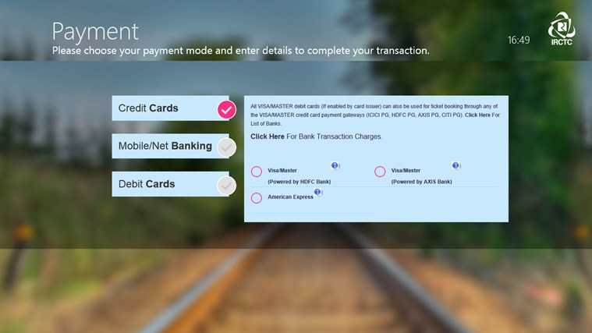
“This might be the biggest coup for Microsoft in India. IRCTC, the notorious Indian Railways train ticket booking website known for its crashes and slowness under usual heavy Indian loads has received an exclusive app for the Windows Phone 8 and Windows 8 platforms, developed in partnership with Microsoft.”
– Bharadwaj, Fonearena
“Electronic tickets account for approximately 48 per cent of the tickets sold every day… making the website figure in the list of top ranking e-commerce sites in the country.”
– The Economic Times
CLOSED CAPTIONING TEXT AREA

Slide 20

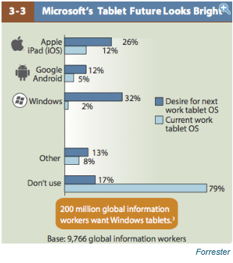


2%
200 million global information workers would like to use a Microsoft Windows tablet for work
32%
12%
26%
5%
12%
Current work tablet
Desired next work tablet
Windows 8 in the Enterprise
Forrester

Slide 21

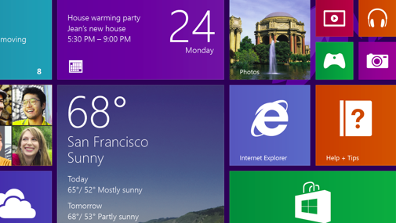
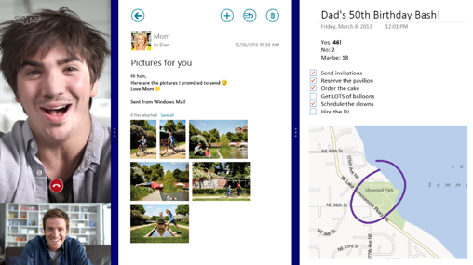
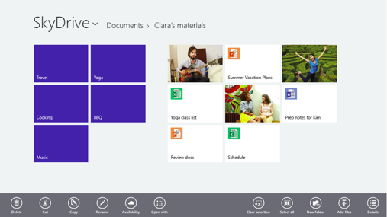
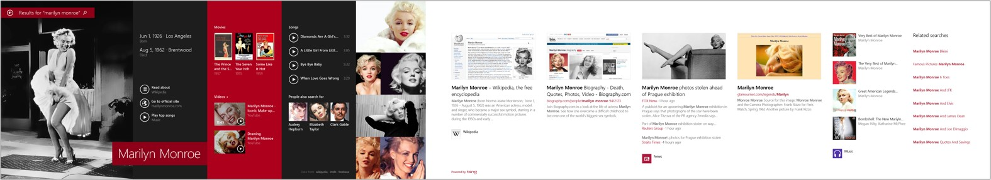
8.1 More powerful and efficient
Personalized start and lock screens
New live tile sizes, including large
Apps share the screen
Deep SkyDrive integration
Rich, integrated search driven by Bing

Slide 22




Slide 23
Services

Slide 24






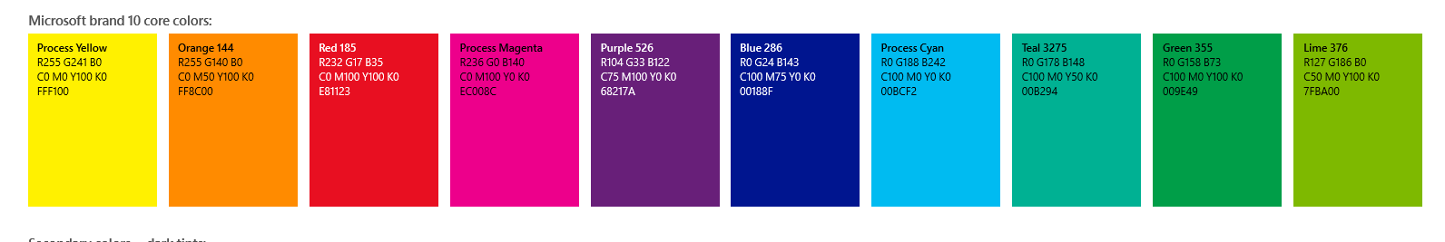



Proven experience
Azure
Bing holds 17.86 percent of US market share
Nearly 50 million Office Web Apps users
Skype users spend up to 2 billion minutes per day using the service
Over 250 million people have a SkyDrive
1.5 Billion games of Halo
On average, over 1,000 new customers sign up for Windows Azure every day
48 Million Subscribers
299 Million connected users
Yammer now has over 7 million registered users
11 billion stored photos
Outlook.com has over 400 million active users and is the world’s fastest growing email service
1 Billion mobile notifications a month
50 percent of Fortune 500 companies use Azure
Xbox delivered over 18 billion hours of entertainment in 2012

Slide 25



Windows in the cloud

Slide 26
public
cloud
.NET
Hyper-V
Visual Studio
System Center
Active Directory
hybrid cloud
private cloud

Slide 27
Programming Model + Tools
Identity
Integration
Data
IaaS + PaaS
Microsoft Cloud Infrastructure

Slide 28




extend
dev, test, run
mobile
web

Slide 29








●
Open Platform

Slide 30
Common Core

Slide 31





Programming skills
Development tools
Languages, frameworks
Components
Runtimes

Slide 32

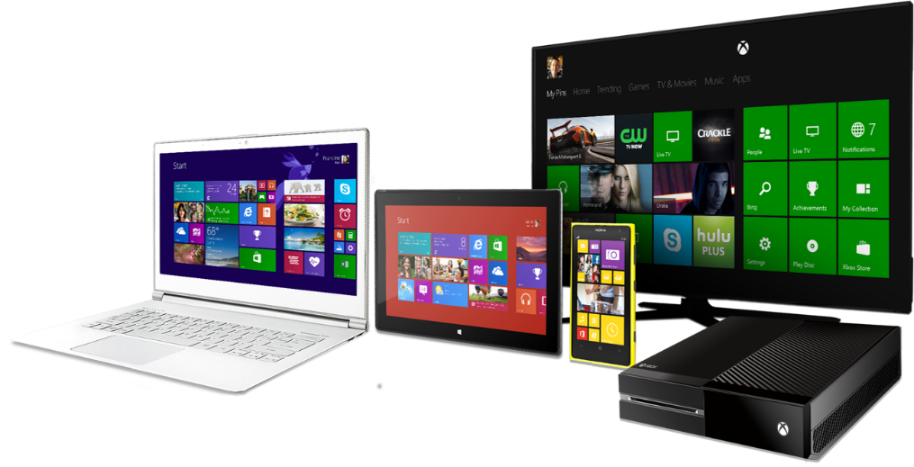
Great device experiences …
… powered by services
in the cloud

Slide 33

Create new experiences
Reach more people
Better economics
Use what you know

